Slide 1
Airline Delay Data Analysis and Building Machine Learning models
By Sherri Son, Ivan Brajkovic, Maya Quinanola, and Natasha Tretter

Slide 2
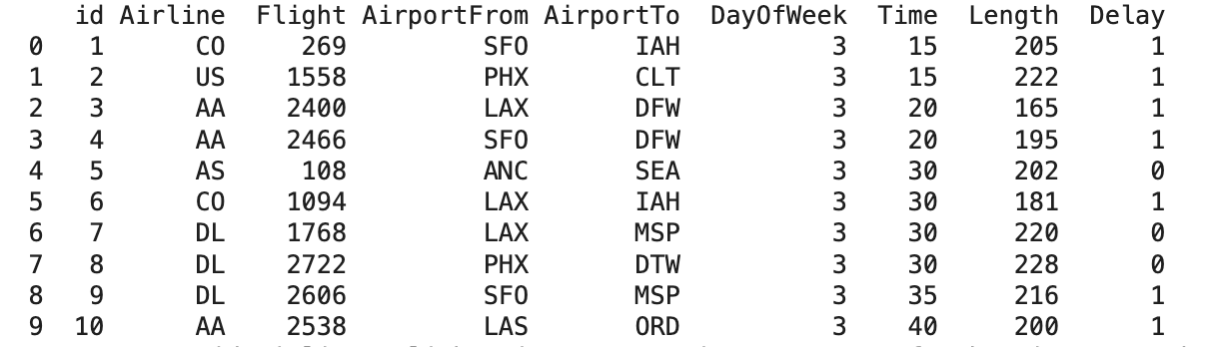
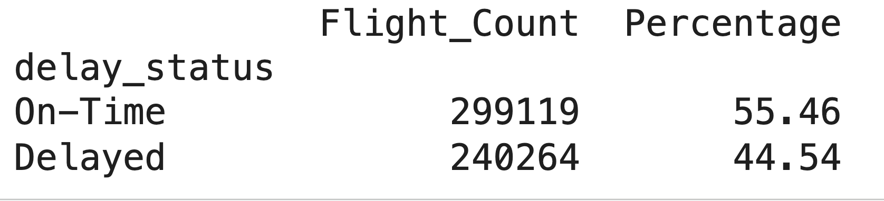
Data Introduction
▶ Data Name
Airlines dataset to predict a delay
Originally designed to build a prediction model whether a given flight will be delayed
▶ Data Source
https://www.kaggle.com/datasets/jimschacko/airlines-dataset-to-predict-a-delay?resource=download
▶ Data Size & Column Names
Shape : (539383, 9)
Columns : ID, Airline, Flight, AirportFrom, AirportTo, DayOfWeek,Time,Length,Delay
▶ Data Overview
▶ Data Distribution

Slide 3
2. Project Introduction
▶ Project Goals
▶ Hypotheses
(1) Find the characteristics of delayed flights and verify the hypotheses
(2) Build effective machine learning models to predict the flight delay (Random Forest, K-means, and Decision Tree)
H1: The airlines and airports considered as the major ones would have more delayed flights than the others
H2: Sunday Evening time would be the highest delay time, since the demands for the flight for Sunday and earlier flight delay influences
H3: Longer flight has the biggest delay rate compare to shortest flights due to operational complexity and crew scheduling.

Slide 4
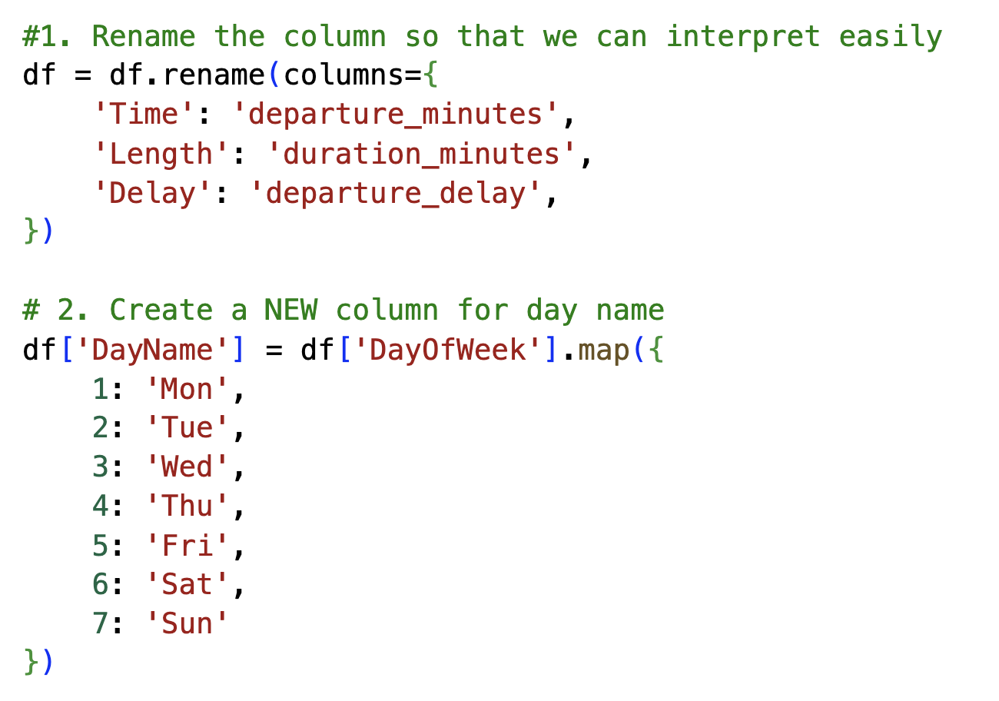
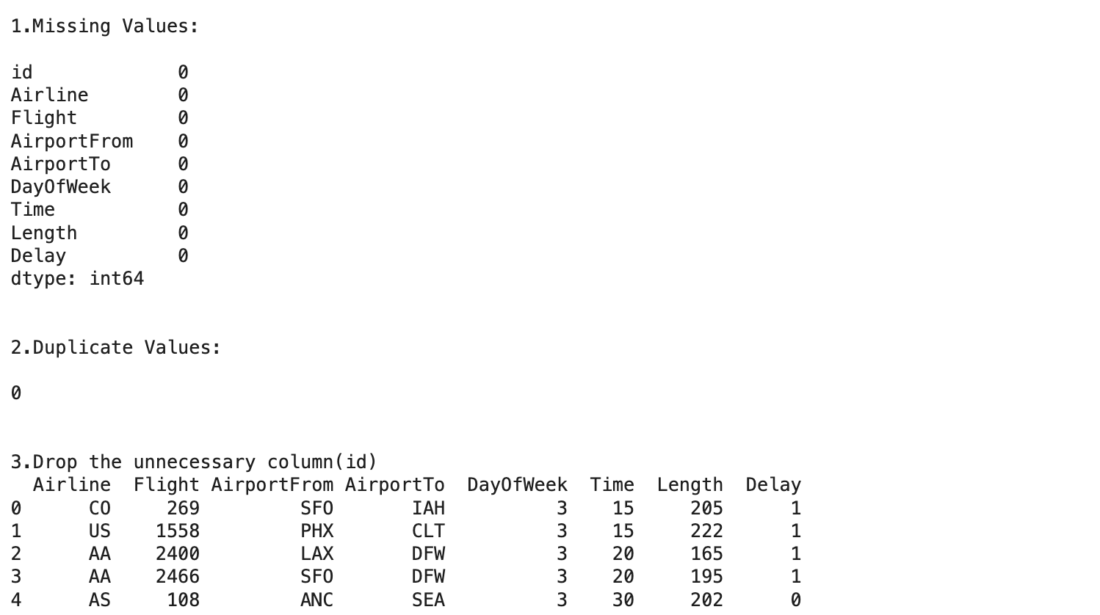
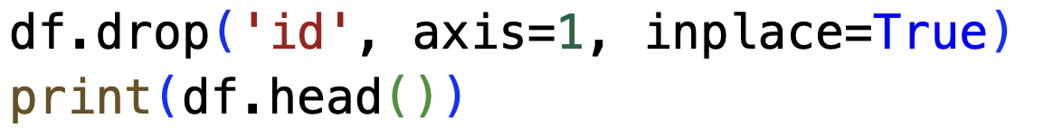
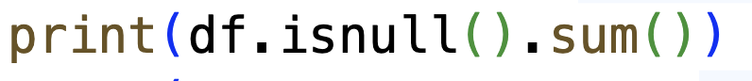
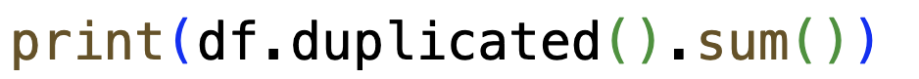
3. Data Cleaning
1) Finding Missing Values and Duplicate Values
2) Drop unnecessary column (ID)
3) Renaming Columns
[Time],[Length],[Delay]
:[departure_minutes], [duration_minutes], [departure_delay]
[DayOfWeek] -> [DayName]
1: Mon, 2: Tue, 3: Wed -> 7: Sun

Slide 5
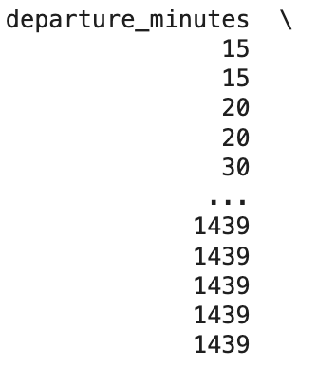
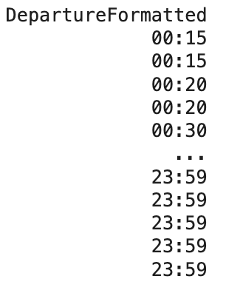
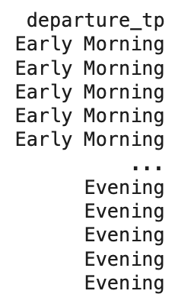
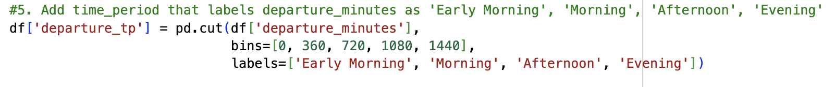
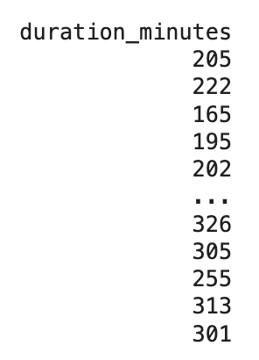
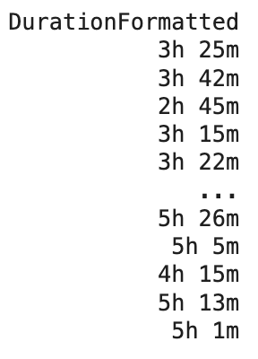
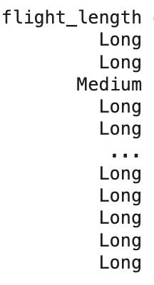
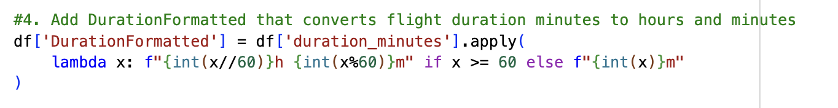
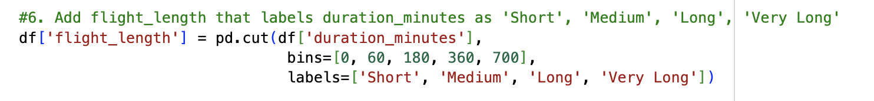
3. Data Cleaning
4) Adding Columns from ‘departure_mintues’(Time) and ‘duration_minutes’ (Length)
Notes:
Í

Slide 6
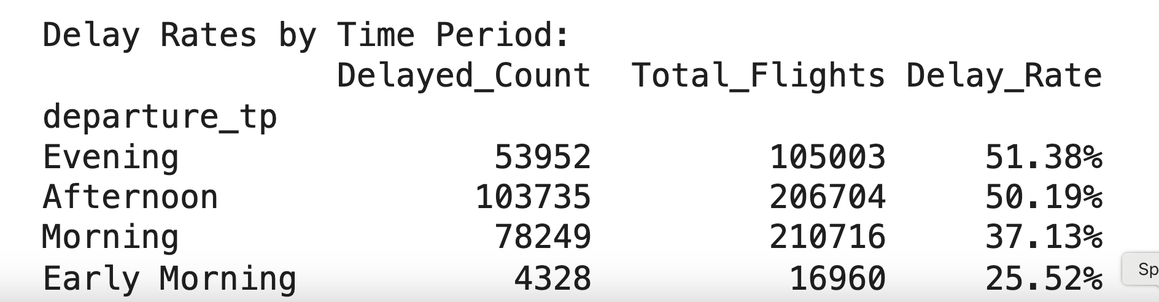
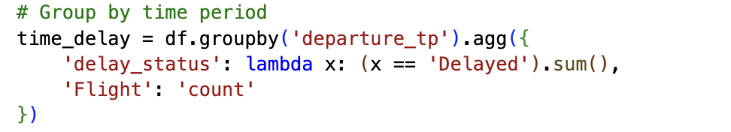
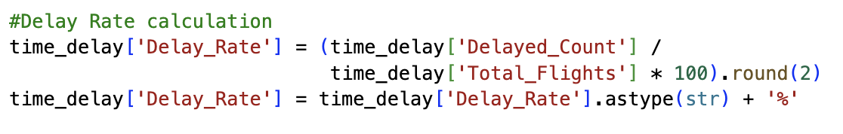
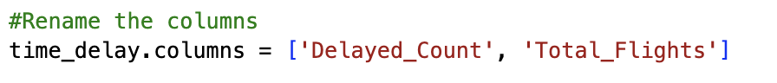
4. Hypotheses Verification Methodology
▶ Hypotheses Verification Step
(1) Aggregation(groupby)
(2) Renaming
(3) Delay Rate Calculation
(4) Sorted by value, highest to lowest delay rate

Slide 7
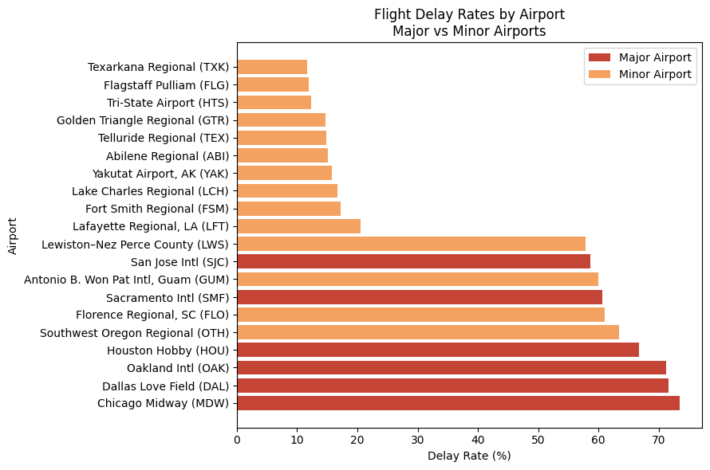
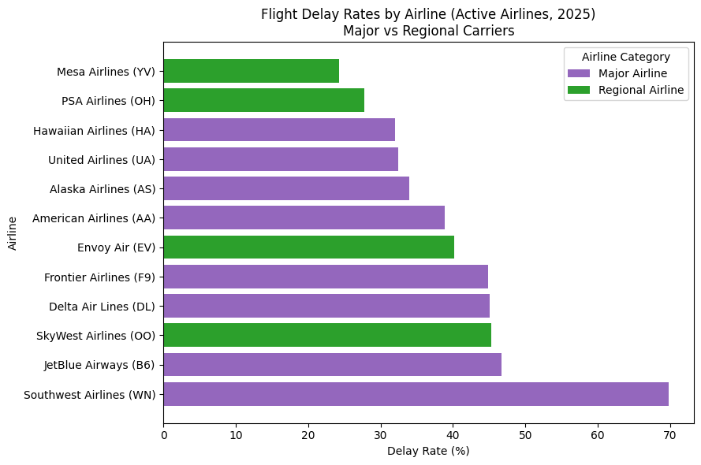
H1: Major airlines and airports experience more flight delays than smaller ones.
▶ Answer: YES. However, airline graph shows weaker correlation than the airport graph.

Slide 8
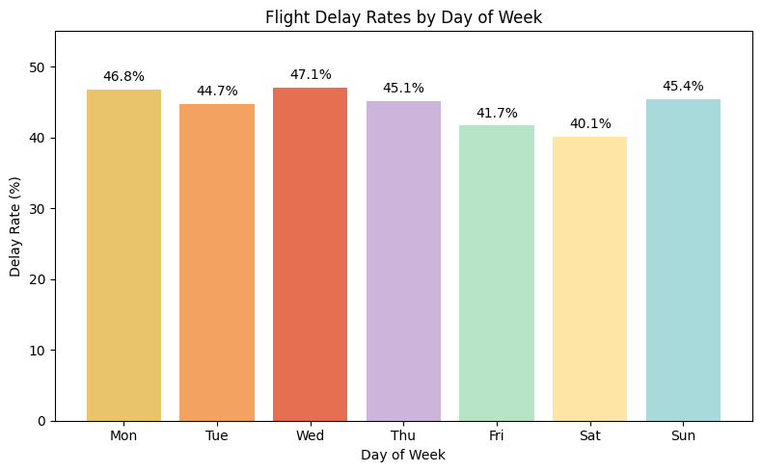
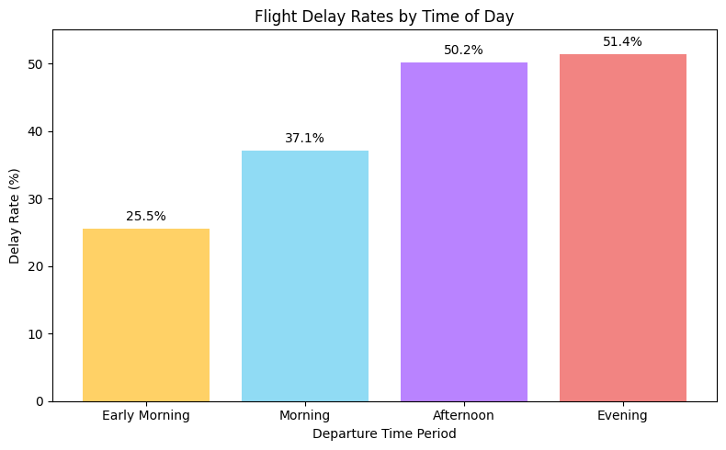
H2: Sunday evening flights have the highest delay rates due to peak demand and accumulated delays
▶ Answer: NO. Wednesday evening flights have the highest delay rates, not Sunday.

Slide 9
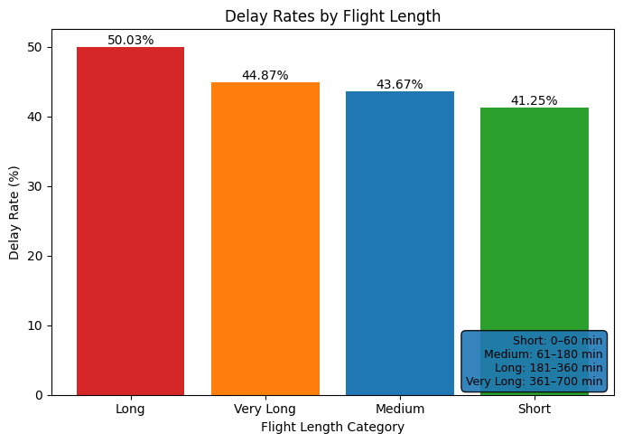
H3: Long-haul flights experience higher delay rates than short-haul flights due to operational complexity.
▶ Answer: YES. ‘Very Long’ and ‘Long’ flights have higher delay rates than Medium and Short flights.
▶ ‘Very Long’ Flights:
Finding : Delay rates increase with flight length, but very long flights show lower delays than long flights, indicating a non-linear relationship.
Short: 0–60 min
Medium: 61–180 min
Long: 181–360 min
Very Long: 361–700 min

Slide 10
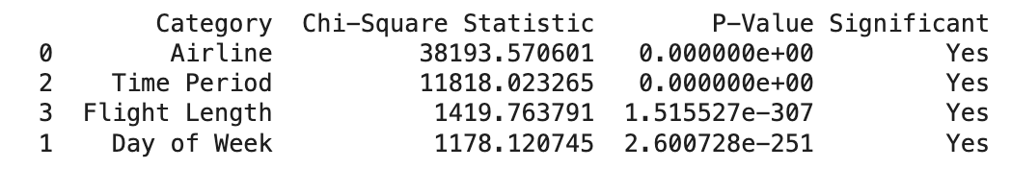
5. Statistical Verification
▶ P-value Test and Chi-Square Test
10⁻³⁰⁷
10⁻²⁵¹
P-Value Testing : Since the p-value is below 0.05, the associations are statistically significant,suggesting that all examined factors are related to flight delays.
Chi-Square Testing : Based on the chi-square values, the strength of association decreases in the following order: Airline - Time Period - Flight Length - Day of Week.

Slide 11
Building classification models (kNN, Decision Trees, and Random Forest
Does the data allow for construction of classification models?
Can there be any accurate predictions based on this slew of data?

Slide 12
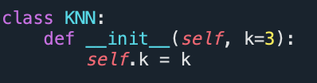
kNN classification model
Making a kNN it’s own class (easier to run when done multiple times)
This is basically something stored in the kNN class’ memory (k=3 will always be associated with the class KNN)

Slide 13
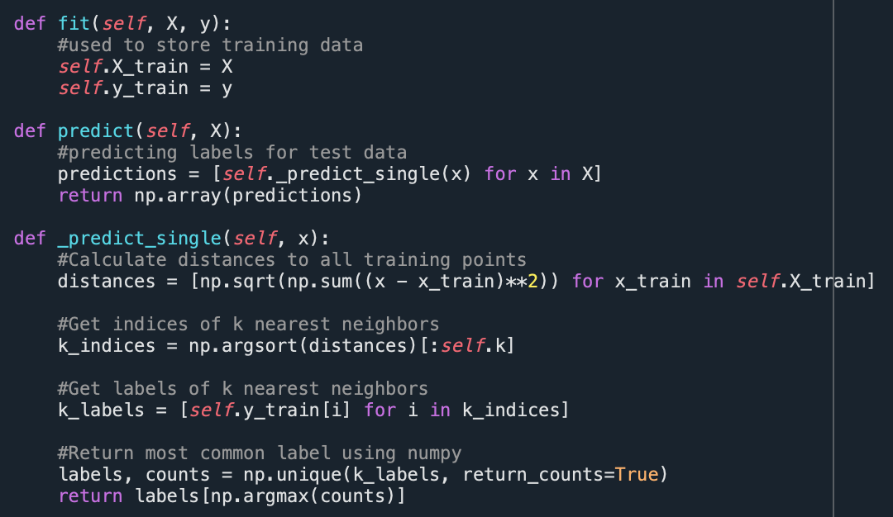
kNN classification model CON’T
Def fit
Basically what stores the training data for kNN
Def predict
Making predictions for multiple data points at one singular time going through all X values (attributes) in the array in the CSV
Def _predict_single
Using Euclidian distance in order to calculate distance with nearest neighbors (k=3)
k_indices
Takes only the nearest instances
k_labels
What creates the labels for the nearest neighbors calculate

Slide 14
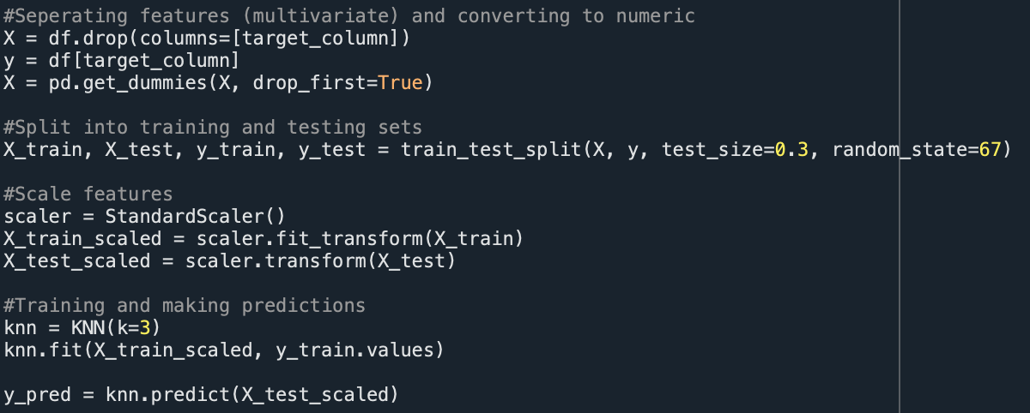
kNN classification model CON’T
X and Y being separated
Pd.get_dummies is what converts categorical data into a yes/no
For kNN, using a 70/30 split for training data and test data to test efficacy of the program
Scalar just normalizes within the function for knn (best practice to avoid crazy variation)

Slide 15
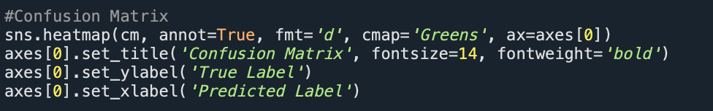
Visualization 1: Confusion Matrix
annot=True
This is what allows the values to show up in each box
Cmap
Sets colors based on those in the packages
Sns.heatmap
Package that allows for the creation of a confusion matrix with less formatting

Slide 16
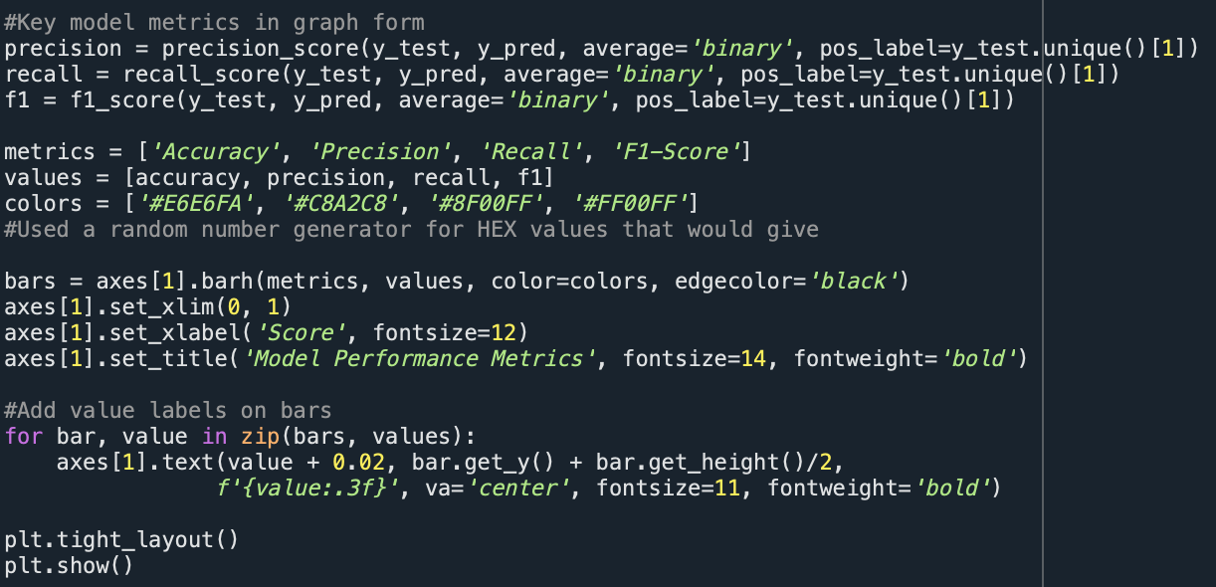
Visualization 2: Key Metrics
Precision, recall and F1 are all metrics use to analyze how effective the model is at predicting based on the data given
Bars
Sets the bar graph to show the scores of the metrics

Slide 17
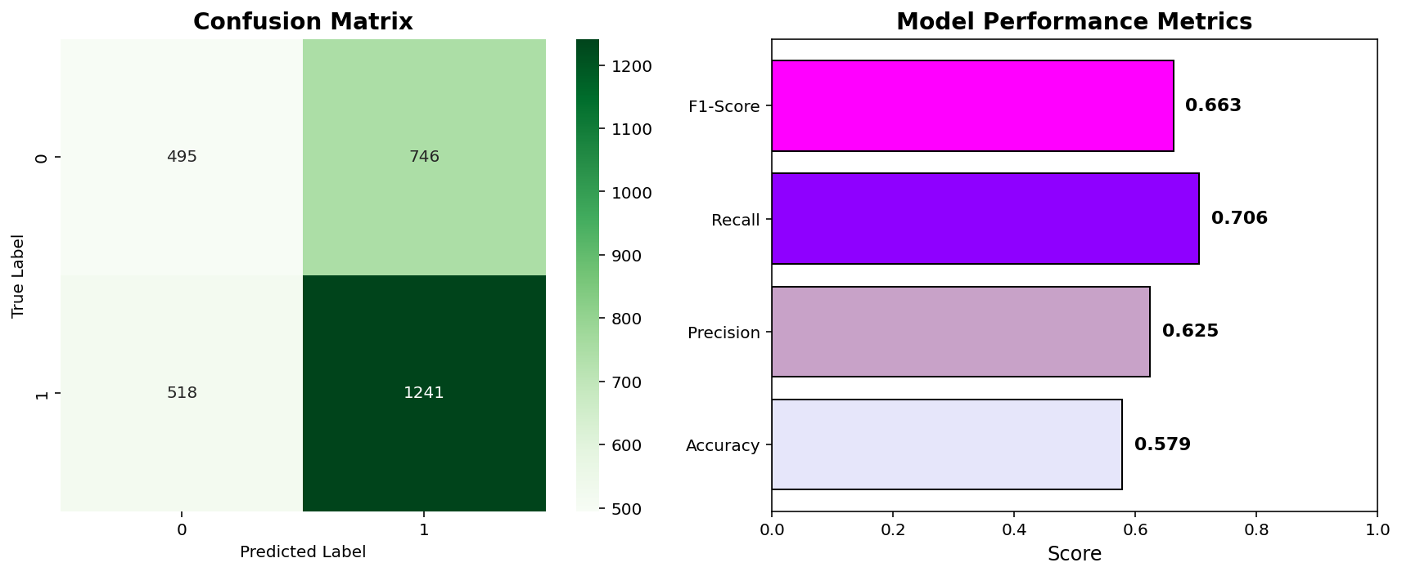
Results
True Negative (TN)
False Positive (FP)
False Negative (FN)
True Positive (TP)
*note about data size

Slide 18
Result CON’T
Recall: out of the true positive results, how many did the kNN model actually classify as true positive? (70.6%)
Precision: when the model predicts positive, how many times is it actually correct? (62.5%)
F1 Score: how well it handles false negatives and false positives (combination of recall and precision)
Accuracy: out of all points, how many were correctly classified?

Slide 19

Improvements
Include seasonal variations (holiday’s, natural disasters/occurrences)
Include other metrics of flights (size of flight, transfer, etc.)
Include international flights

Slide 20
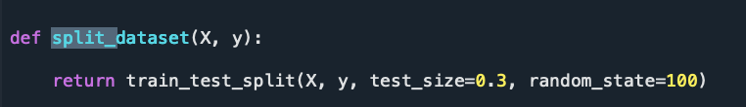
Splitting data up
Dataset split into:
70% training
30% testing
Random state fixed (random_state = 100)
No data leakage between training and test sets
Notes:
Train–Test Split Strategy
Dataset split into:
70% training
30% testing
Split performed before model training
Random state fixed (random_state = 100) to ensure reproducibility
Test set used only for final evaluation
No data leakage between training and test sets
Why this matters:
Ensures unbiased evaluation
Simulates performance on unseen flights

Slide 21
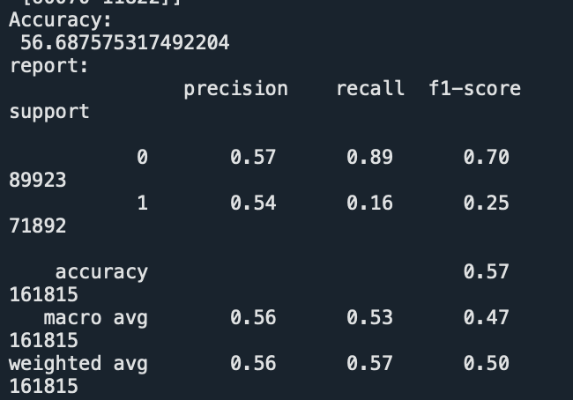
Comparison: Baseline
DecisionTreeClassifier(
criterion ="entropy",
random_state = 100,
max_depth = 3,
min_samples_leaf = 5
)
Accuracy = 56.68
Delayed Recall = .16
F1 Score = .25
Notes:
This model serves as our baseline, meaning it represents the simplest version of our approach with minimal tuning or control. We used a decision tree with the entropy criterion, which selects splits based on information gain.
The model was configured with a shallow depth of 3 and a small minimum leaf size of 5, allowing the tree to make quick, simple splits while still being flexible enough to learn patterns from the data.
We did not apply class weighting
We did not address class imbalance
We did not apply a custom threshold
The model uses the default 0.5 probability cutoff
the model struggles to accurately identify delayed flights and tends to favor the majority class.

Slide 22
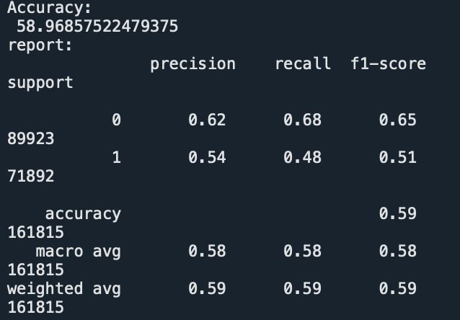
Comparison: Controlled
clf_entropy = DecisionTreeClassifier(
criterion="entropy",
random_state=100,
max_depth=10,
min_samples_leaf=100,
class_weight="balanced"
)
Accuracy = 58.3
Delayed Recall = 0.48
Delayed F1 = .51
Notes:
“This model is a controlled decision tree, meaning we constrained the model’s complexity using parameters such as maximum depth, minimum samples per leaf, and class weighting, but did not manually adjust the prediction threshold.
By setting max_depth = 10 and min_samples_leaf = 100, we reduced overfitting and forced the tree to make broader, more general decisions rather than memorizing noise in the training data. The use of class_weight = 'balanced' helped address class imbalance by penalizing misclassification of delayed flights more heavily during training.

Slide 23
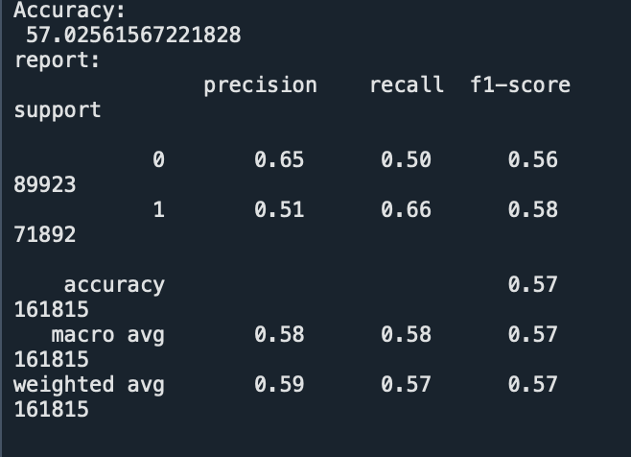
Comparison: threshold
def prediction(x_test, clf_entropy, threshold=0.45):
y_prob = clf_entropy.predict_proba(x_test)[:, 1]
y_pred = (y_prob >= threshold).astype(int)
return y_pred
DecisionTreeClassifier(
criterion="entropy",
random_state=100,
max_depth=5,
min_samples_leaf=10,
)
Accuracy = .57
Delay Recall = .66
Delay f1 score = .58
Notes:
A controlled model means we intentionally adjusted how the model makes its final classification decisions. Instead of simply predicting a flight as delayed when the predicted probability is greater than 50%, we introduced a custom threshold to better balance performance metrics.
The threshold controls how confident the model must be before labeling a flight as delayed. By increasing or decreasing this threshold, we can control the tradeoff between:
Recall (catching as many delayed flights as possible), and
Precision / accuracy (avoiding false delay predictions)
You tested thresholds:
0.50 (too aggressive)
0.45 (best option)
0.40 (too conservative)

Slide 24
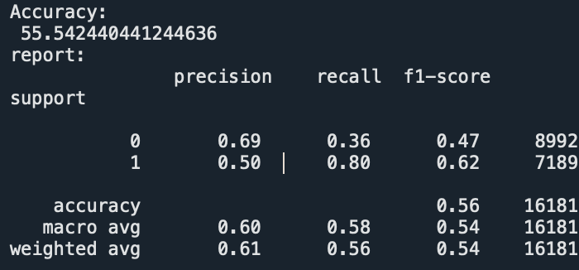
Comparison: threshold + balanced
def prediction(x_test, clf_entropy, threshold=0.45):
y_prob = clf_entropy.predict_proba(x_test)[:, 1]
y_pred = (y_prob >= threshold).astype(int)
return y_pred
DecisionTreeClassifier(
criterion="entropy",
random_state=100,
max_depth=5,
min_samples_leaf=10,
class_weight = ‘balanced’
)
Accuracy = 55
Delay Recall = .80
Delay f1 score = .62
Notes:
80% of delayed flights
It has the highest F1 score for the class you care about
Accuracy drop is small and expected
This is the correct choice for an imbalanced classification problem
However it has a .36 recall for on-time arrivals this would be a safe option
You tested thresholds:
0.50 (too aggressive)
0.45 (best option)
0.40 (too conservative)

Slide 25
Analyzation
Best Overall Model:
Balanced Controlled Decision Tree with threshold
Rejected models:
Baseline → poor delay detection
Controlled w/out threshold → similar but with wins
Threshold .4 & .5 → too many false alarms
Notes:
The model we ultimately selected is a balanced, controlled decision tree with a tuned threshold that intentionally favors delayed flights. This model prioritizes recall for delayed flights while keeping false alarms at an acceptable level.
We chose this approach because in the context of flight operations, missing a delay is more costly than predicting a delay that does not occur. By favoring delayed flights, our final model provides the most realistic and actionable predictions, making it the best overall model.”

Slide 26
Takeaways
Can not rely on accuracy alone for imbalance datasets
Class balancing improves recall
Threshold tuning provides meaningful control over predictions
Notes:
Slide 10 — Conclusions & Takeaways
Key Findings:
Accuracy alone is insufficient for imbalanced datasets
As we saw in the baseline comparison accuracy was decent but delay recall was low
Class balancing + feature engineering dramatically improves recall
Threshold tuning provides meaningful control over predictions

Slide 27
Random Forest
Random Forests are classification algorithms.
derive from decision trees
assign each observation(s) made to a final category by a majority vote over a set of trees
reduces var{y} by building multiple trees using random subsets of data and random subsets of attributes
each tree:
trains on random subset of flights
considers a random subset of features
Random Forest was used to improve predictive reliability and identify which flight characters matter most, but does NOT test any of the three hypotheses directly

Slide 28
Random Forest - Dataset
Dataset Used: Modified_Airlines.csv
each row = one flight
Target Variable: delay_status
0; flight on time
1; flight was delayed
df = pd.read_csv(“Modified_Airlines.csv”)
df [“delay_status”] = df [“departure_delay”].map ({
0: “On-Time”
1: “Delayed”})
df_model[target] = df_model [target].map({
“On-Time”: 0,
“Delayed”: 1})

Slide 29
Random Forest - Known Variables
day of week
departure time (minutes)
flight duration
flight length
time of day
features = [
“DaysOfWeek”,
“departure_minutes”,
“duration_minutes”,
“departure_tp”]

Slide 30
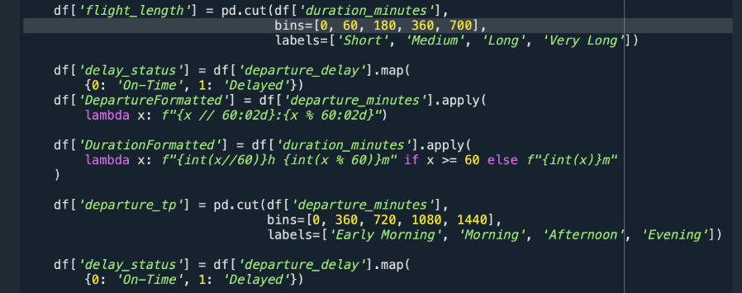
Random Forest - Data Encoding
Encoding prompts ordering:
categories here represent increasing ranges (time, length, etc.)

Slide 31
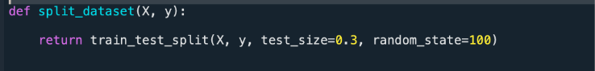
Random Forest - Splitting Data
70% training / 30% testing
allows for fair evaluation of predictive performance on the data

Slide 32
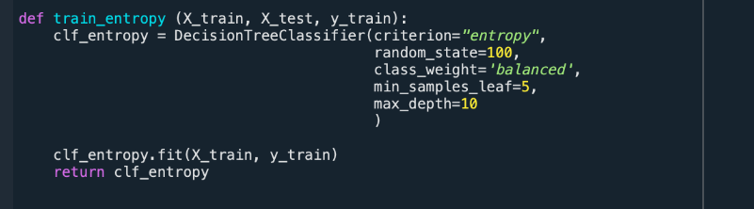
Random Forest - Back to the Baseline: The Decision Tree

Slide 33
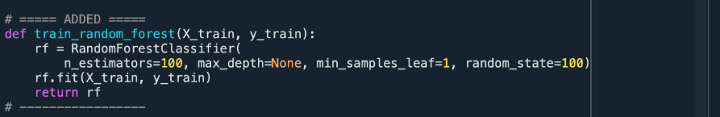
Random Forest -
rf = RandomForestClassifier(
n_estimators=100,
max_depth=None,
min_samples_leaf=1,
random_state=100)
#aggregates many trees

Slide 34
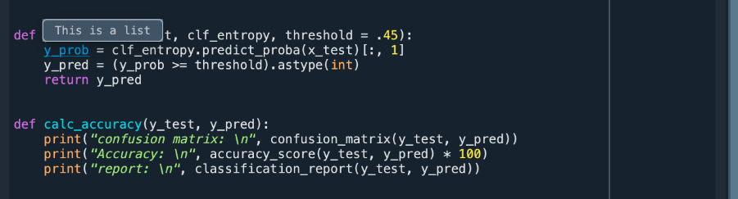
Random Forest - Prediction
applies a threshold of 0.45

Slide 35
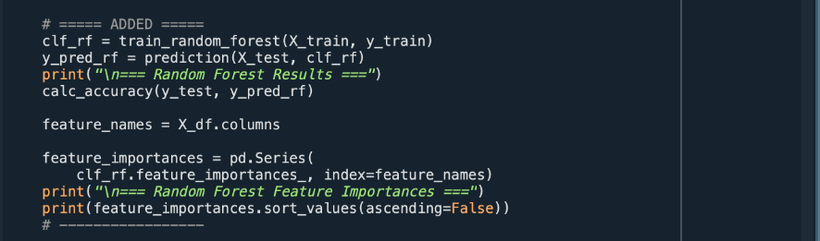
Random Forest - Findings
time-based variables dominate prediction
departure timing matters > the flight length
random forest is a more classified categorical test than a simple decision tree

Slide 36
print(“Thank you!”)

